Slide 1

Logic
By Ariel Avshalom
Lecture 2
CISC 2210

Slide 2

What we’ll cover
Sections 3.4, 3.5 and 3.6 of the book: https://www.people.vcu.edu/~rhammack/Discrete/Alpha.pdf

Slide 3
Swapping implications (We call this converse statements)
P | Q | P ⇒ Q | Q ⇒ P
0 | 0 | 1 | 1
1 | 0 | 0 | 1
0 | 1 | 1 | 0
1 | 1 | 1 | 1

Slide 4

Example
P | Q | P ⇒ Q | Q ⇒ P
0 | 0 | 1 | 1
1 | 0 | 0 | 1
0 | 1 | 1 | 0
1 | 1 | 1 | 1
P = (a is a multiple of 6)
Q = (a is divisible by 2)
a is a multiple of 6 ⇒ a is divisible by 2 $≇$ a is divisible by 2 ⇒ a is a multiple of 6
The above graphic does not necessarily apply to this case but all cases of conditionals.

Slide 5
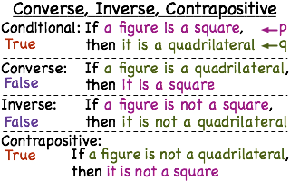
Note on converse statements
Sometimes the converse statement can be true, but that is not always the case
This is because the logic as shown above is not congruent or equivalent
Conversely (no pun intended), contrapositive statements are congruent to the conditional

Slide 6
The biconditional
There are cases when the conditional and its converse have the same truth value (either both true or both false).
When this occurs, we call it the biconditional ⇔
The biconditional can be translated to
(P ⇒ Q) ∧ (Q ⇒ P)
This is read as P if Q and P only if Q or P if and only if Q (P IFF Q)

Slide 7
Biconditional truth table
P | Q | P ∧ Q | P ⇒ Q | Q ⇒ P | P ⇔ Q | (P ⇒ Q) ∧ (Q ⇒ P)
0 | 0 | 0 | 1 | 1 | 1 | 1
1 | 0 | 0 | 0 | 1 | 0 | 0
0 | 1 | 0 | 1 | 0 | 0 | 0
1 | 1 | 1 | 1 | 1 | 1 | 1

Slide 8
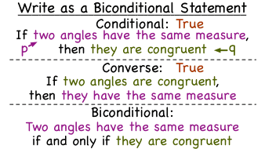
A side note from proofs
Later, one of the types of proofs we’ll look at are proving biconditional statements are true
Generally one side of the proof is trivial (this does not necessarily mean easy!) and the other side is difficult

Slide 9

Biconditional example
1: P = (a is even)
2: Q = (a is divisible by 2)
3: P ⇒ Q $=$ a is even ⇒ a is divisible by 2 TRUE
4: Q ⇒ P = a is divisible by 2 ⇒ a is even TRUE
5: P ⇔ Q implies 3 and 4 are TRUE

Slide 10

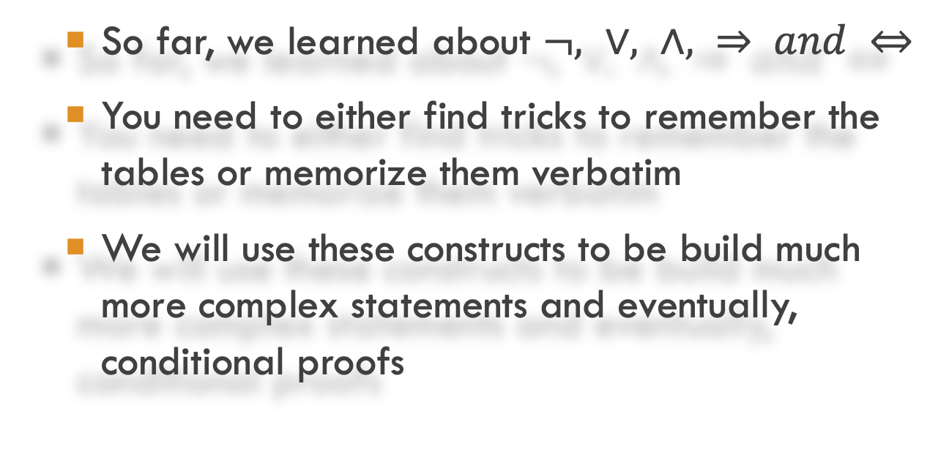
Constructing complex statements
So far, we learned about $¬, ∨, ∧, ⇒ and ⇔$
You need to either find tricks to remember the tables or memorize them verbatim
We will use these constructs to be build much more complex statements and eventually, conditional proofs

Slide 11
A review of truth tables
P | Q |  | ¬P | ¬Q
0 | 0 |  | 1 | 1
1 | 0 |  | 0 | 1
0 | 1 |  | 1 | 0
1 | 1 |  | 0 | 0
P | Q |  | P ∨ Q | P ∧ Q
0 | 0 |  | 0 | 0
1 | 0 |  | 1 | 0
0 | 1 |  | 1 | 0
1 | 1 |  | 1 | 1
P | Q |  | P ⇒ Q | Q ⇒ P | P ⇔ Q
0 | 0 |  | 1 | 1 | 1
1 | 0 |  | 0 | 1 | 0
0 | 1 |  | 1 | 0 | 0
1 | 1 |  | 1 | 1 | 1

Slide 12
Example of a complex statement: (P ∨ Q) ∧ ¬ (P ∧ Q)
(P ∨ Q) ∧ ¬ (P ∧ Q) can be read as
P or Q is true, and both P and Q are not true
This means that one of the statements can be true but both can’t be

Slide 13
Constructing a truth table
 | P | Q | (P ∨ Q) | (P ∧ Q) | ¬ (P ∧ Q) | (P ∨ Q) ∧ ¬ (P ∧ Q)
 | 0 | 0 | 0 | 0 | 1 | 0
 | 1 | 0 | 1 | 0 | 1 | 1
 | 0 | 1 | 1 | 0 | 1 | 1
 | 1 | 1 | 1 | 1 | 0 | 0
Steps | 1 | 1 | 2 | 2 | 3 | 4

Slide 14

Logical equivalences
Two statements can be equivalent to each other
We can prove equivalence using truth tables
$$≡$$

Slide 15
Example of logical equivalences
P | Q | ¬P | ¬Q | ¬Q ⇒ ¬P | P ⇒ Q
0 | 0 | 1 | 1 | 1 | 1
1 | 0 | 0 | 1 | 0 | 0
0 | 1 | 1 | 0 | 1 | 1
1 | 1 | 0 | 0 | 1 | 1
1 | 1 | 2 | 2 | 3 | 2

